Slide 1
Australia rain prediction
-By Shivam Mishra

Slide 2
Introduction
In this project I am going to download the Dataset form the Kaggle and will perform the different tasks.
I am going to check the rain prediction of Australia.
I will take the examples to check the rain predictions.
In this project we will clean the data, make the charts and graphs to visualize the dataset, find accuracy , etc.
The whole project is made by using python language and its libraries.

Slide 3
logistic regression
Logistic Regression is a commonly used technique for solving binary classification problems. In a logistic model :
We take linear combination
We apply the sigmoid function to the result to obtain a number between 0 and 1.
This number represents the probability of the input being classified as “Yes”.
Instead of RMSE, the cross entropy loss function is used to evaluate the results .

Slide 4
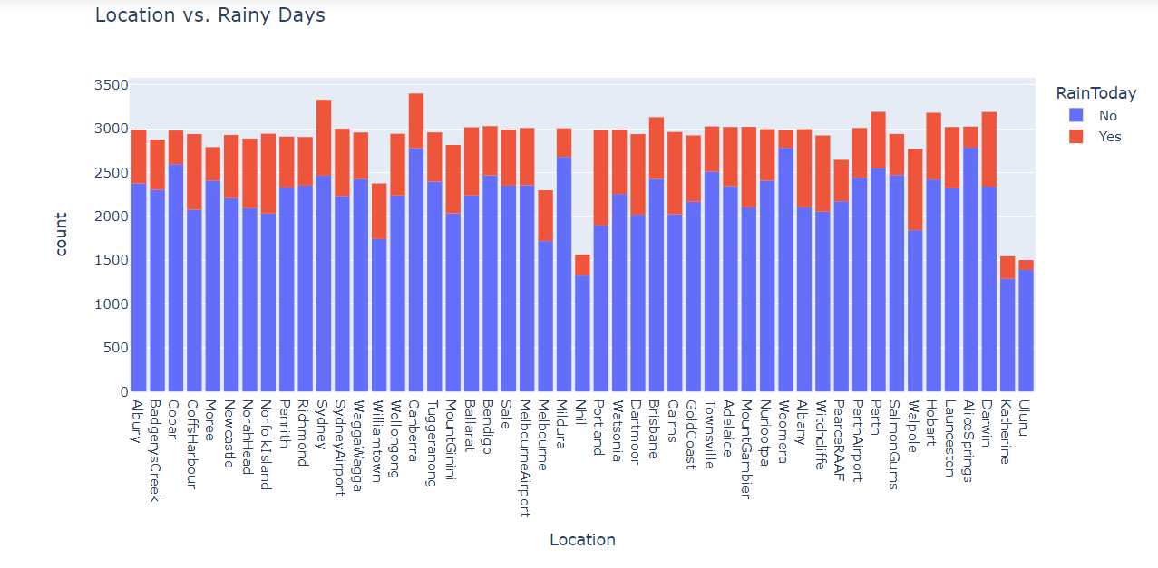
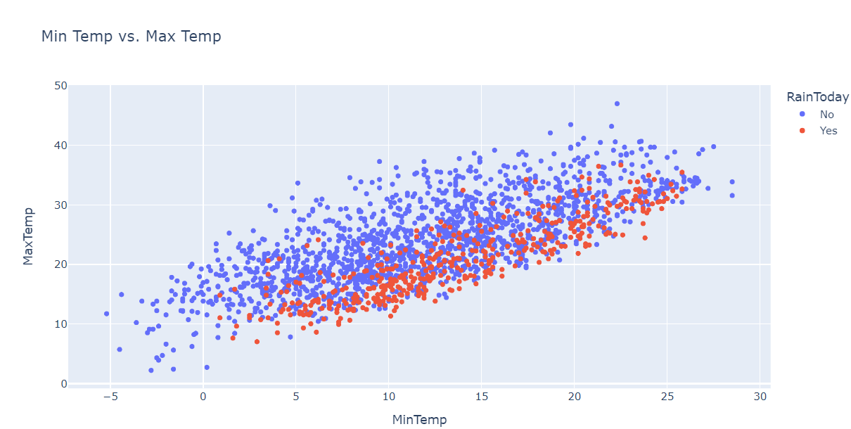
Exploratory Data analysis & Visualization
Before training machine learning model, its always a good idea to explore the distribution of various columns and see how they are related to the target column.
I have plotted the graphs and charts to visualize the datasets -

Slide 5
Training, validation and test sets
While building real – world machine learning models, it is quite common to split the dataset into 3 parts :
1. Training Set : - used to train the model i.e., copute the loss and adjust the model’s weights using an optimization technique.
2.Validation Set : - used to evaluate the model during training, tune model hyperparameters(optimization technique, regularization, etc.), and pick the best version of the model. Picking a good validation set is essential for training models that generalize well.

Slide 6
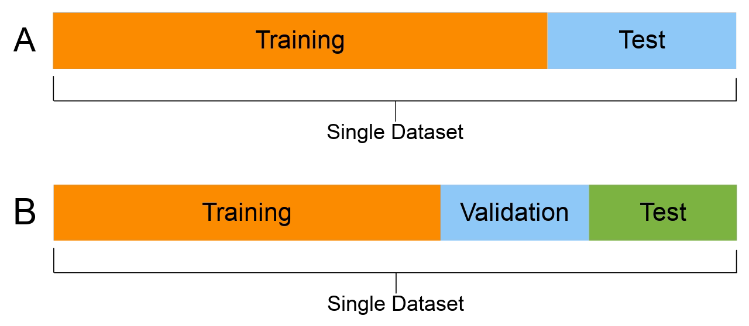
3. Test Set :- used to compare different models and report the model’s final accuracy. For many datasets, test sets are provided separately. The test set should reflect the kind of data the model will ensure in the real world, as closely as feasible.

Slide 7
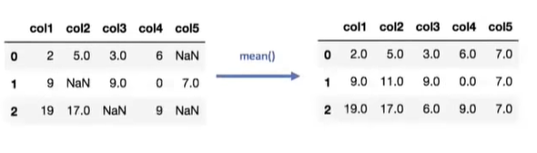
Imputing Missing Numeric Data and Categorical Data
Machine Learning models can’t work with missing numerical data. The process of filling missing values is called imputation.
There are several techniques for imputation , but I have used the SimpleImputer class from sklearn.impute.

Slide 8
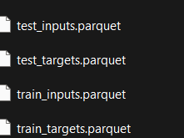
Parquet
It can be useful to save processed data to disk, especially for really large datasets, to avoid repeating the preprocessing steps every time you start the Jupyter Notebook.
The parquet format is a fast and efficient format for saving and loading Pandas DataFrames.

Slide 9
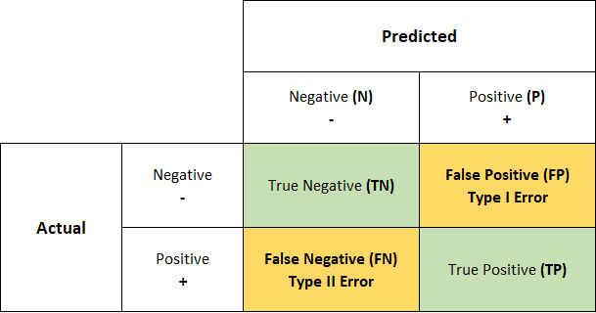
Confusion matrix
A confusion matrix is a table that is used to define the performance of a classification algorithm. A confusion matrix visualizes and summarizes the performance of a classification algorithm.

Slide 10
Conclusion
During training the model I got 85.1% of accuracy.
In this algorithm I got best accuracy so we can say that this dataset is best to predict the rain of Australia.

Slide 11
Thank You…!

